Slide 1
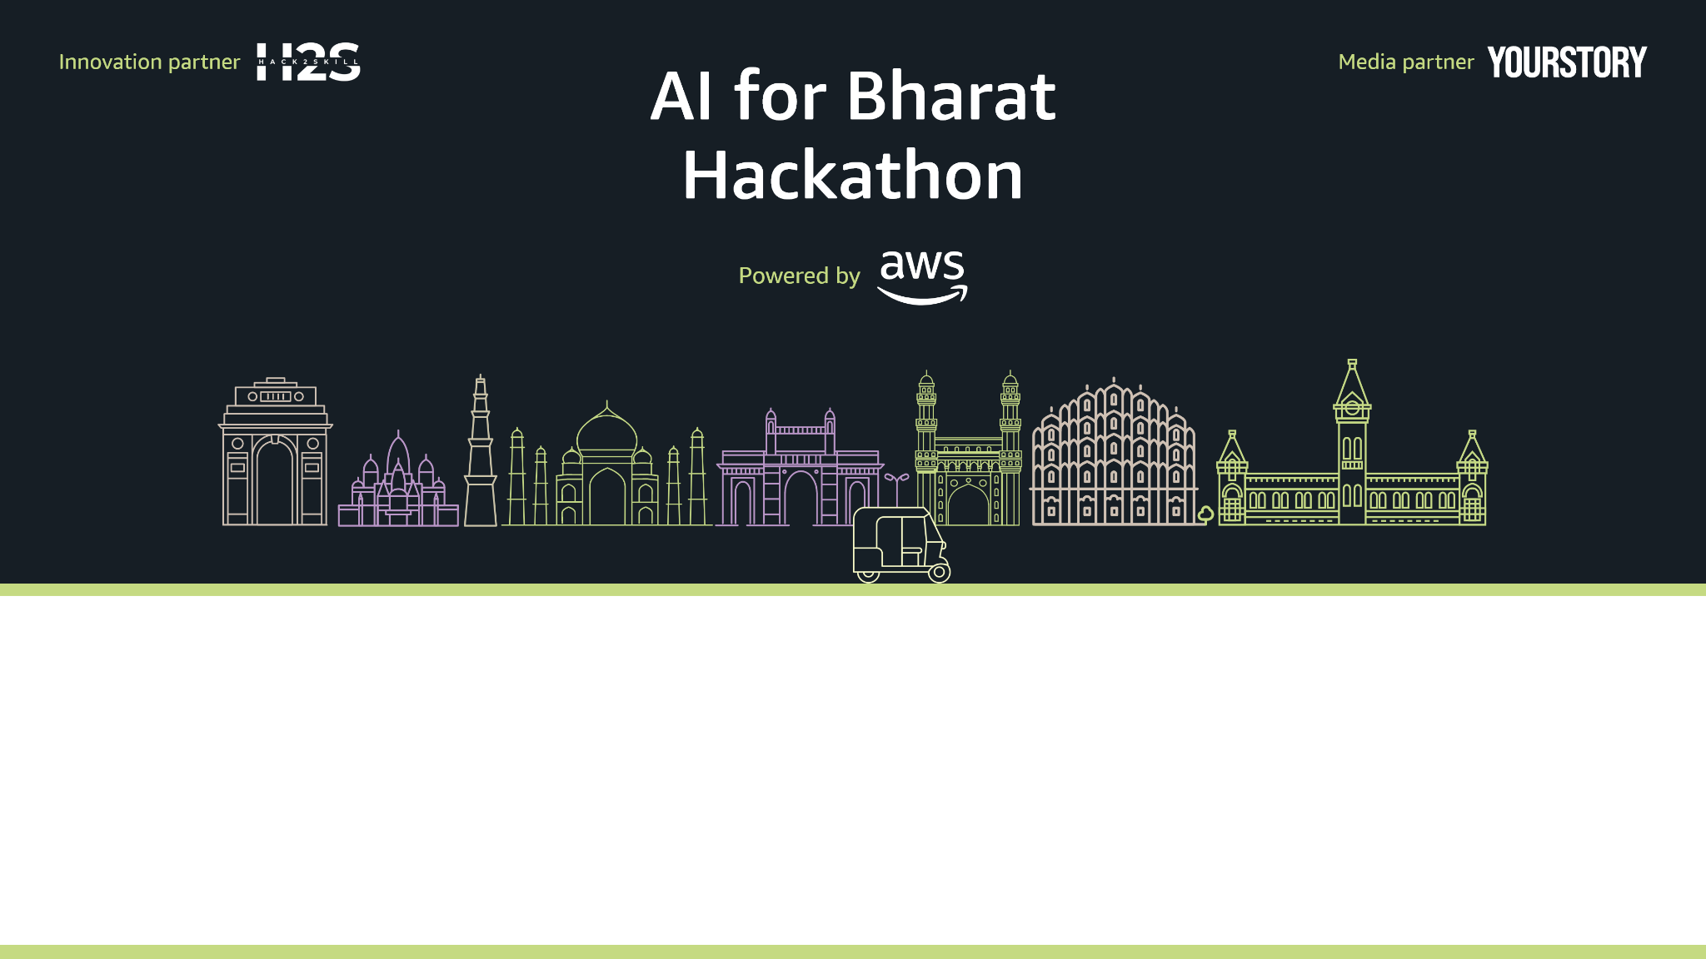
Team Name : Coding Beasts
Team Leader Name : Arjun Kumar
Problem Statement : Design an AI-powered solution that improves efficiency and reduces operational burden within healthcare ecosystems by assisting clinicians with time-consuming clinical documentation tasks.

Slide 2
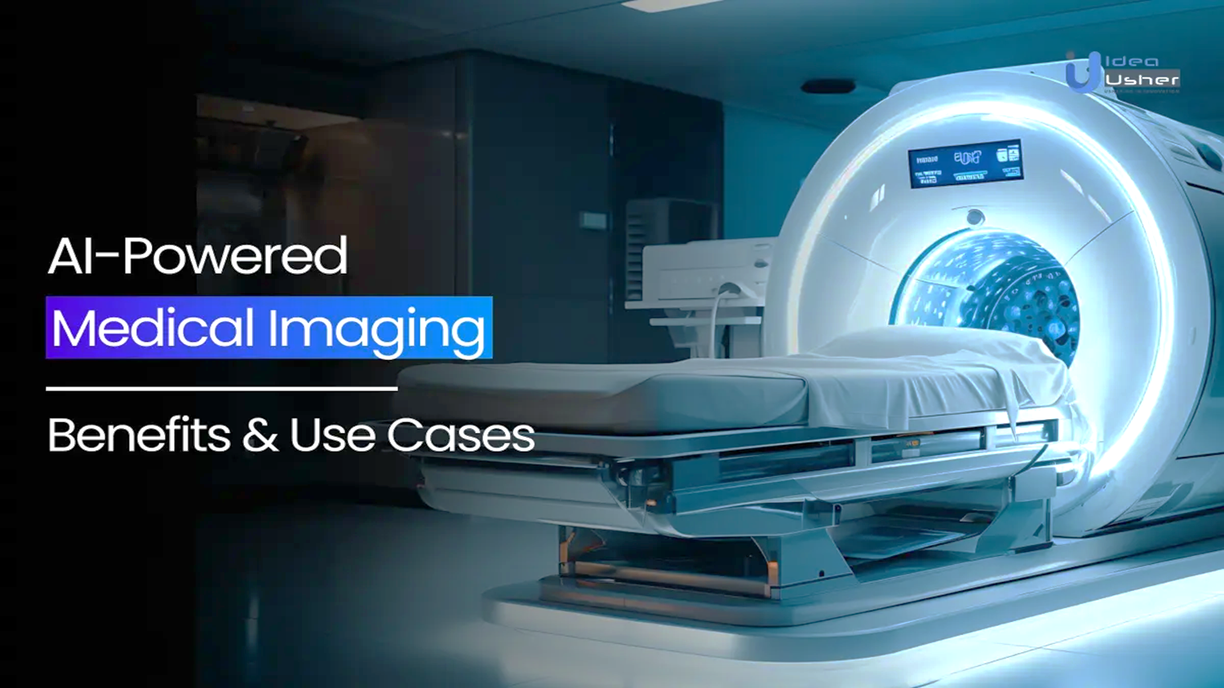
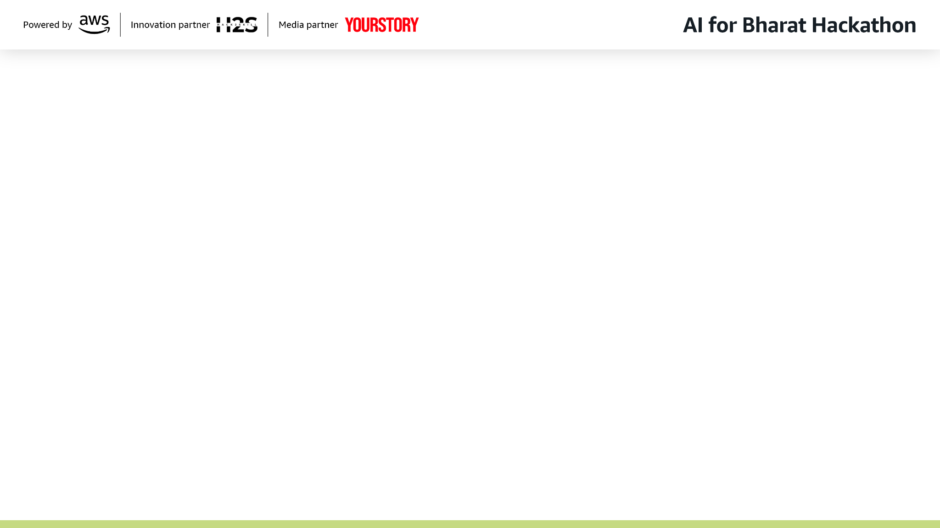
MedScript AI – Idea Overview
MedScript AI is an AI-powered clinical documentation assistant that reduces the time doctors spend on manual note-taking during patient consultations. It helps improve efficiency and allows doctors to focus more on patient care.
The system converts natural doctor–patient conversations into structured SOAP notes, which doctors review and approve before saving. AI acts only as a support tool, ensuring accuracy, safety, and doctor control.

Slide 3
How it is differ from existing one??
MedScript AI stands apart from existing documentation tools by focusing on natural doctor–patient conversations rather than rigid templates.
Unlike heavy EHR-integrated platforms, it is lightweight, browser-based, and accessible in low-resource settings. Its human-in-the-loop design ensures doctors remain in control, while productivity metrics provide measurable impact.
This combination of accessibility, safety, and innovation makes MedScript AI uniquely practical for real-world healthcare.
Feature | Competitors | MedScript AI
Medical Understanding | General transcription | Clinical NLP with context
Specialty | Support One-size-fits-all | 15+ specialties
Training Data | Often requires patient data | 100% synthetic + public data
EHR Integration | Standalone | Seamless direct integration
Learning | Static | Adaptive to physician reference

Slide 4
How will it solve the problem & USP
MedScript AI solves the documentation burden by converting natural doctor–patient conversations into structured SOAP notes in real time, eliminating repetitive manual note-taking. Doctors review and approve every note, ensuring accuracy, safety, and full clinical control.
Turning conversations into accurate notes, freeing doctors to focus on patients.”
USP: MedScript AI uniquely combines real-time conversational understanding with a human-in-the-loop workflow, enabling faster, more accurate clinical documentation without disrupting existing medical practices—freeing doctors to focus on patient care.
Revolutionizing medical documentation to empower doctors and enhance patient care.

Slide 5
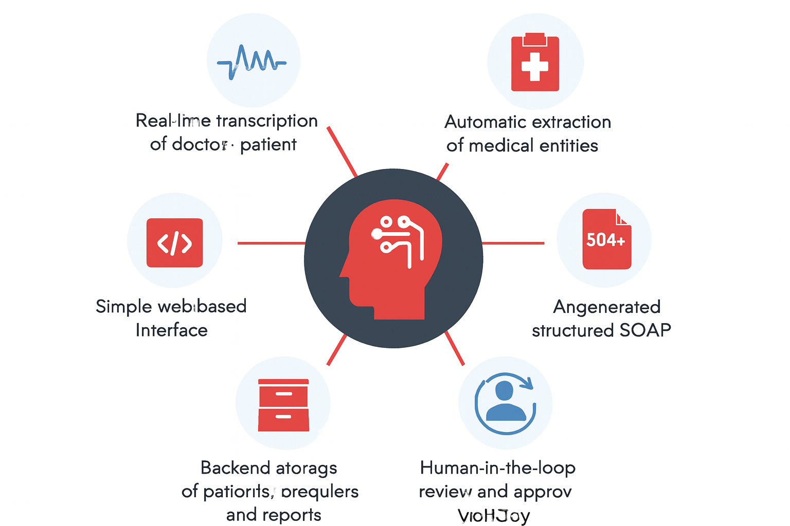
Keys features of MedScript AI
Natural Conversation Understanding
Structured SOAP Note Generation
Patient Intake & Context Integration
Multimodal Symptom Support (Optional)
Human-in-the-Loop Workflow
Dashboard & Productivity Analytics
Lightweight & Accessible Design

Slide 6
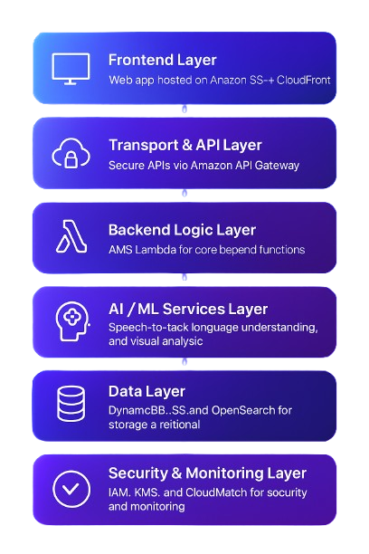
System Architecture Overview Flowchart
Frontend Layer: Web app hosted on Amazon S3 + CloudFront.
Transport & API Layer: Secure APIs via Amazon API Gateway.
Backend Logic Layer: AWS Lambda for core backend functions.
AI / ML Services Layer: Speech-to-text, language understanding, and visual analysis.
Data Layer: DynamoDB, S3, and OpenSearch for storage and retrieval.
Security & Monitoring Layer: IAM, KMS, and CloudWatch for security and monitoring.
External Integrations Layer: EHR and medical coding system integrations.
Workflow Completion: Doctor approval and EHR auto-population.

Slide 7
Technologies to be used in the solution:
Frontend: React.js, React Native, TypeScript, Tailwind CSS
Backend: Node.js/Express, Python FastAPI, Java Spring Boot
AI/ML:
Speech : Amazon Transcribe Medical / Whisper (medical ASR)
NLP: BioClinicalBERT , SciBERT , Custom Medical NER
Generation: Foundation Models via Amazon Bedrock (GPT-based medical models)
Multimodal Analysis: Amazon Rekognition for consent-based facial/body cues
Data: PostgreSQL, MongoDB, Redis, AWS S3, Pinecone
Infrastructure: AWS/Azure, Docker, Kubernetes
Security: AWS KMS, Auth0, HIPAA Compliance Tools
Integration: HL7 FHIR R4, SMART on FHIR

Slide 8
Phase-1
Phase-2
Phase-3
Phase-4
ATLAST
Outcome- 1year Impact
MVP(1-3 Months)
PILOT(4-6 Months)
Launch(7-12 month)
₹40–45 Lakhs
investment
Market-ready, compliant, revenue-generating platform in 12 months
Build the Foundation
Core AI platform development
HIPAA-compliant architecture
Secure infrastructure & APIs
Synthetic data + licensing
💰 Investment: ₹8–10 Lakhs
Validate in Real Clinics
Pilot deployment (3 clinics)
Product refinement & QA
Clinical feedback loop
Independent security audit
💰 Investment: ₹12-15 Lakhs
Scale & Go-to-Market
Scalable product expansion
Marketing & sales execution
Production-grade infrastructure
Enterprise support & ops
💰 Investment: ₹12-15 Lakhs
Revenue & Growth
SaaS Model: ₹1500- ₹2000/ physician / month
200 physicians by Month 12
~ ₹30-40 lakh Year 1 Revenue
High-margin, recurring growth

Slide 9
